Slide 1
Parallel Search Algorithms
CS121 Parallel Computing
Fall 2022

Slide 2
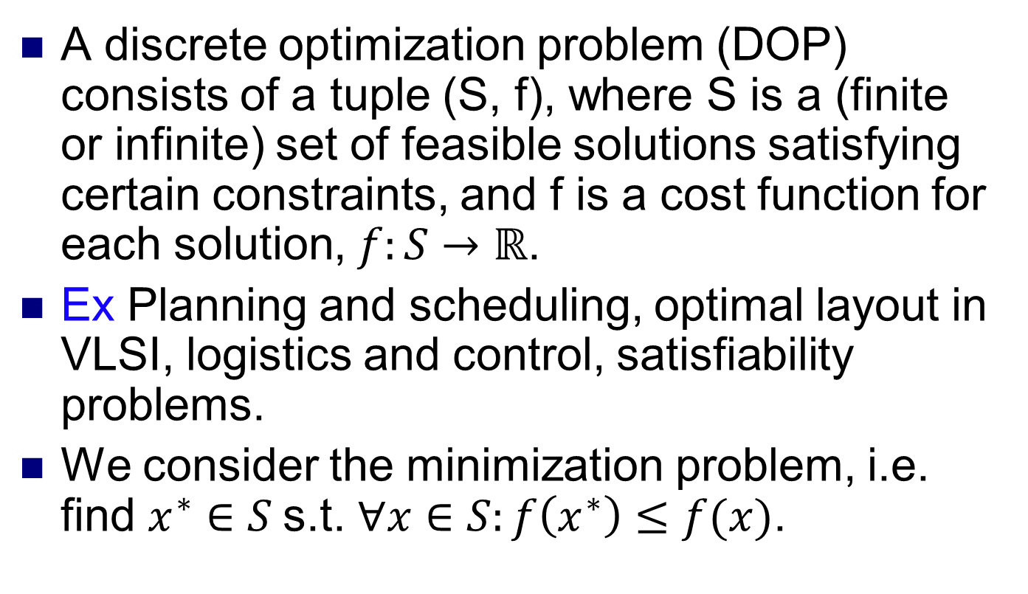
Discrete optimization problems
A discrete optimization problem (DOP) consists of a tuple (S, f), where S is a (finite or infinite) set of feasible solutions satisfying certain constraints, and f is a cost function for each solution, $f:S→ℝ$.
Ex Planning and scheduling, optimal layout in VLSI, logistics and control, satisfiability problems.
We consider the minimization problem, i.e. find $x^{∗}∈S$s.t. $∀x∈S:f\left(x^{∗}\right)≤f(x)$.

Slide 3
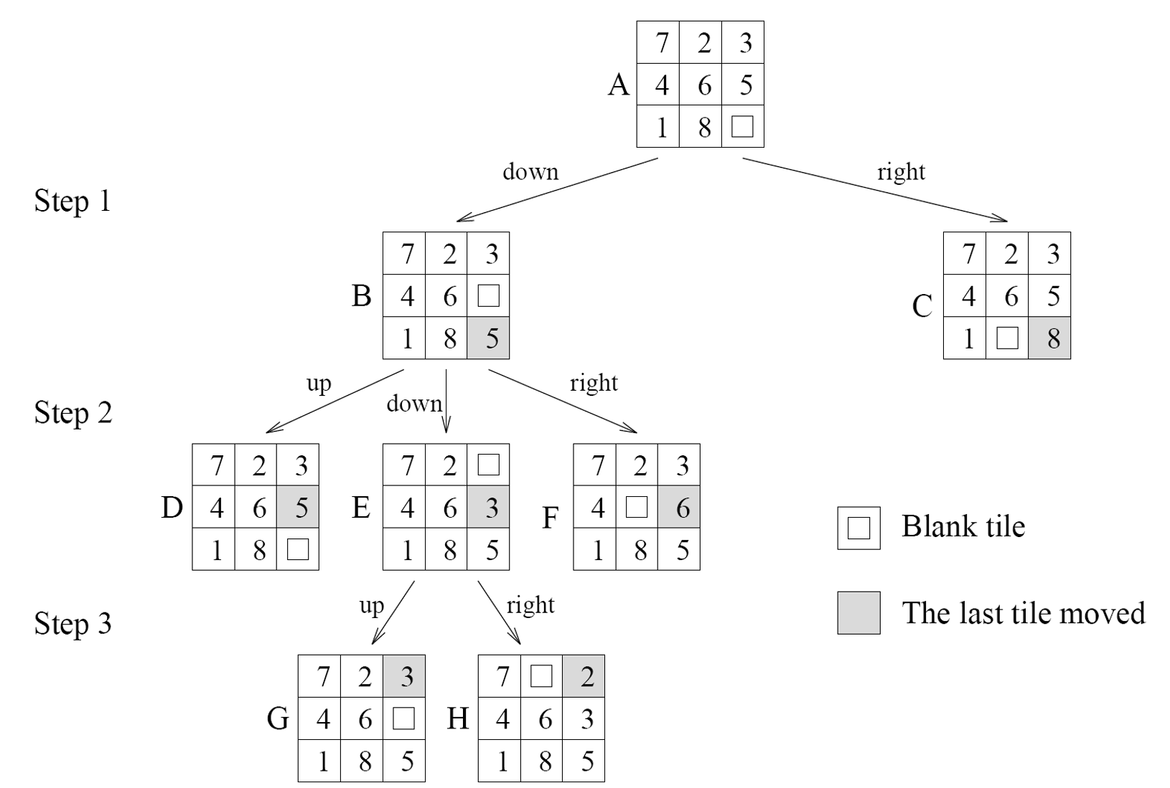
Searching for solutions
Many interesting DOPs are NP-hard, so we either rely on heuristics or search algorithms.
Searching a DOP can be modeled by a graph, with nodes (aka states) being (possibly infeasible) solutions and edges between states that are “close enough”.
Cost of states can be modeled using weights on nodes and edges.
Search process traverses states in some order to find min cost feasible state.
State with no successor in traversal called terminal state. Otherwise it’s a nonterminal state.
Ex 8-puzzle. From starting configuration, move blank tile to lower right so all tiles are in order.

Slide 4
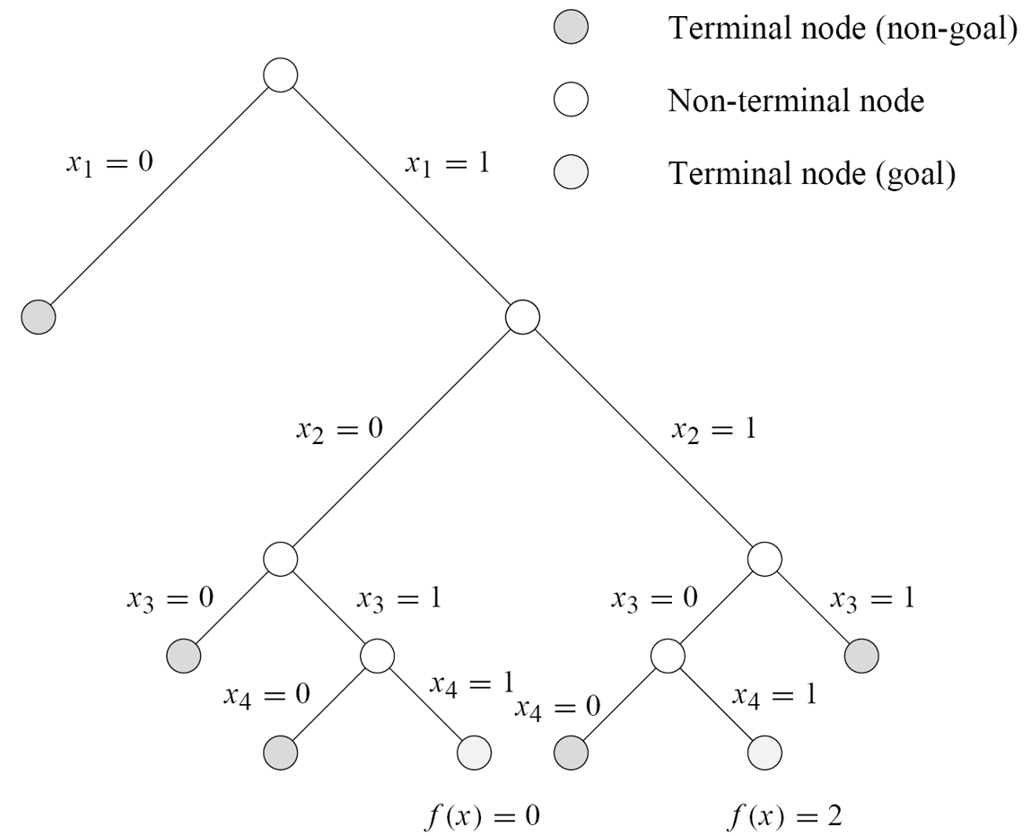
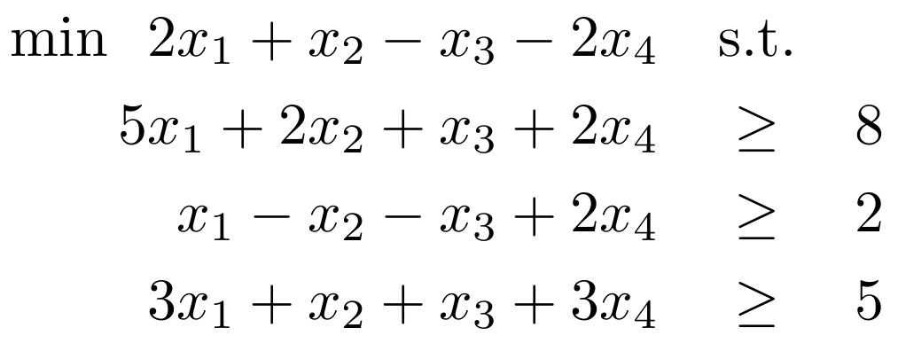
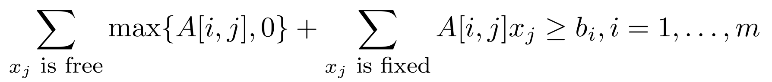
Searching for solutions
Ex A mixed integer program (MIP) consists of a linear objective function and a system of linear constraints, where some of the variables are required to be integers.
States are assignments of values to the variables.
MIPs can model many interesting DOPs, including NP-hard ones.
Ex
Feasible solutions must satisfy

Slide 5
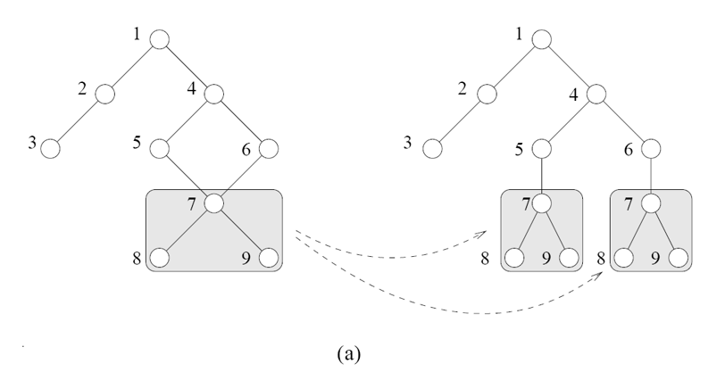
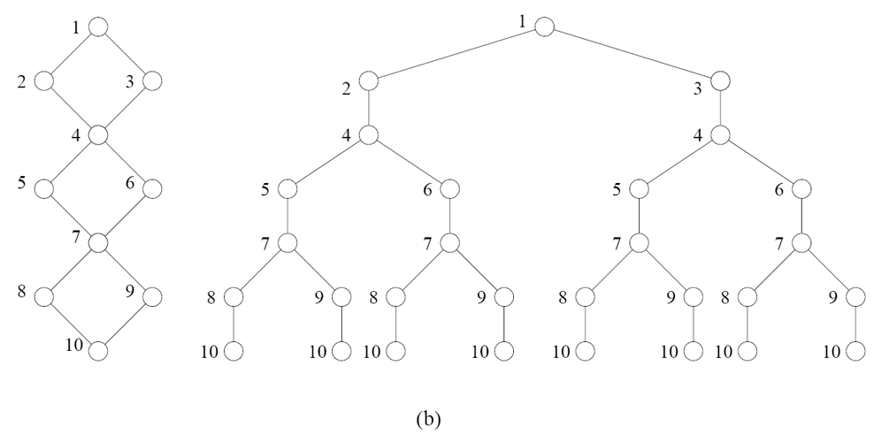
Structure of search graph
When the search graph is a tree, there’s only one way to arrive at each state, and the state has a unique cost determined by the root-state path.
When the search graph is not a tree, there can be multiple paths to each state.
Can unfold graph into a tree to use tree based search methods.
Sometimes unfolded tree much larger than original graph.
Same state may be discovered multiple times.
Use duplicate detection to detect if node has already been explored.
Ex Store explored nodes in hash table.
Cost to the state is the minimum among all the paths.
Update the cost as different paths discovered.
Ex Hash table store both a state and its current min cost.

Slide 6
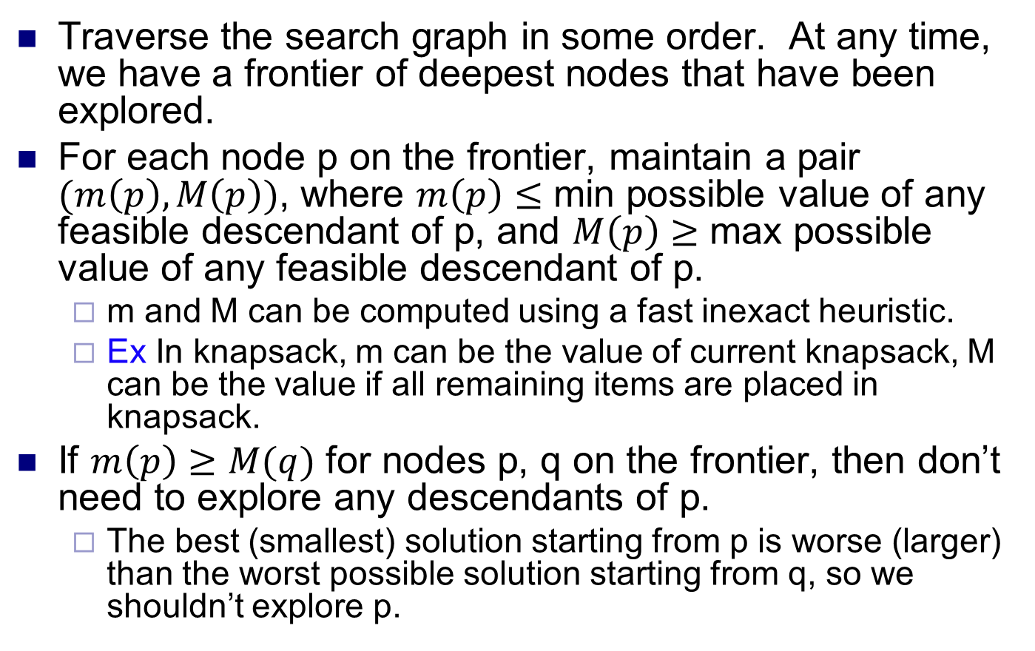
Branch and bound
Traverse the search graph in some order. At any time, we have a frontier of deepest nodes that have been explored.
For each node p on the frontier, maintain a pair $(m\left(p\right), M\left(p\right))$, where $m\left(p\right)≤$ min possible value of any feasible descendant of p, and $M\left(p\right)≥$ max possible value of any feasible descendant of p.
m and M can be computed using a fast inexact heuristic.
Ex In knapsack, m can be the value of current knapsack, M can be the value if all remaining items are placed in knapsack.
If $m\left(p\right)≥M(q)$ for nodes p, q on the frontier, then don’t need to explore any descendants of p.
The best (smallest) solution starting from p is worse (larger) than the worst possible solution starting from q, so we shouldn’t explore p.

Slide 7
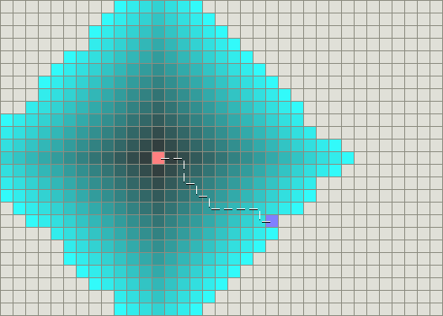
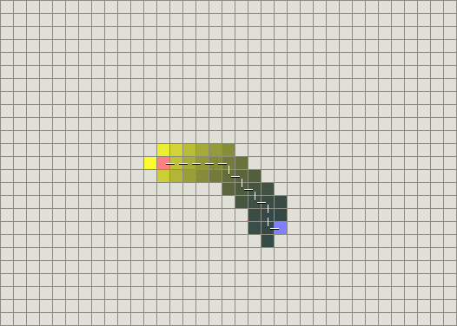
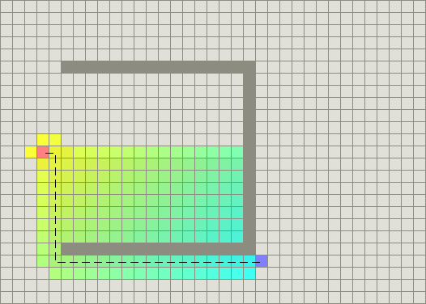
A* search
An improvement of Dijkstra’s shortest path (i.e. min cost) algorithm that searches “most promising” paths first.
For each node n in search graph, let
g(n) = cost from root to n.
h(n) = a lower bound on the cost from n to a solution (aka admissible heuristic).
f(n) = g(n) + h(n), i.e. a lower bound on a solution from n.
A* search expands nodes in order of nondecreasing f(n).
Dijkstra’s expands nodes in nondecreasing order of g(n).
Can be implemented in a similar way to Dijkstra.
Keep a closed list of explored nodes. Their values are already minimal.
Keep an open list of nodes whose values are tentative and can still decrease.
Repeatedly explore min f(n) node. Then update g, h and f functions.
Guaranteed to find min cost solution.
If h(n) close to real cost from n to a solution, then A* searches few nodes and is fast.
Ex h(n) for grid search can be Manhattan distance from n to goal.
Dijkstra’s algorithm
A* search with Manhattan distance heuristic
A* search with an obstacle
Source: http://theory.stanford.edu/~amitp/ GameProgramming/AStarComparison.html

Slide 8
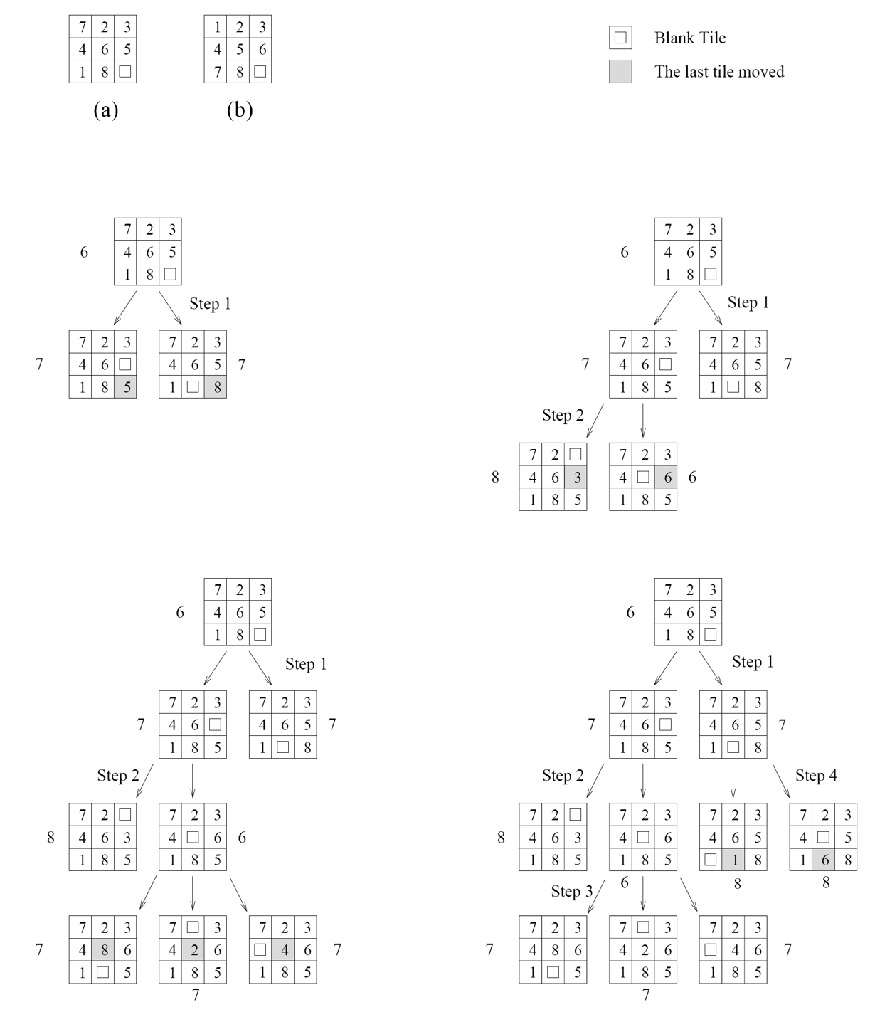
A* search
Ex For 8 puzzle, one possible h₁(n) is number of tiles in incorrect positions.
Ex Another h₂(n) is the sum of the Manhattan distances of each tile from its final position.
Each move of the blank tile moves one numbered tile one position.
Decreases number of states searched by many orders of magnitude.
Can also use h(n) that’s slightly larger than cost from n to goal.
Further reduces number of nodes searched.
Can produce somewhat suboptimal solution.

Slide 9
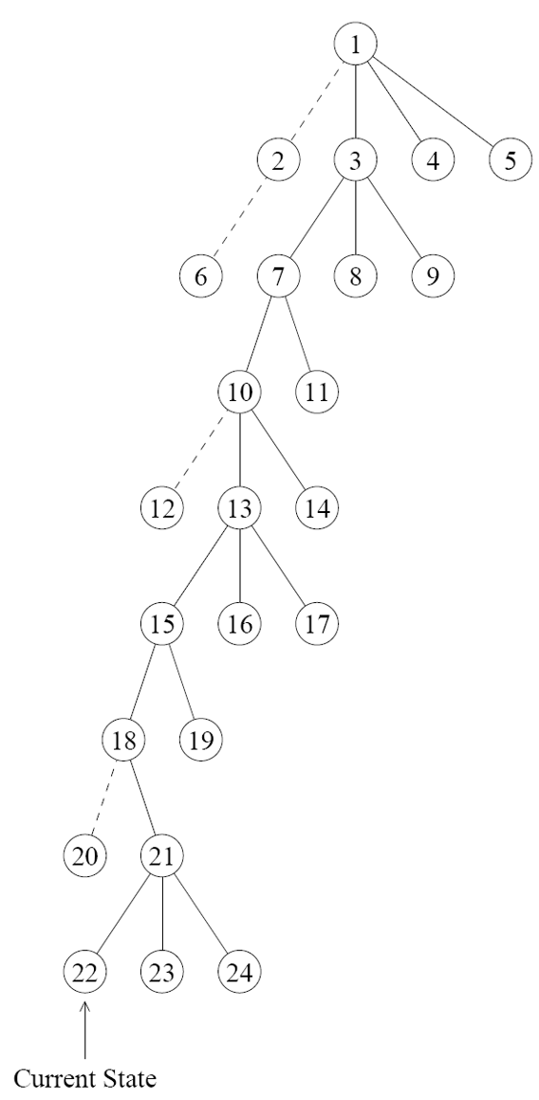
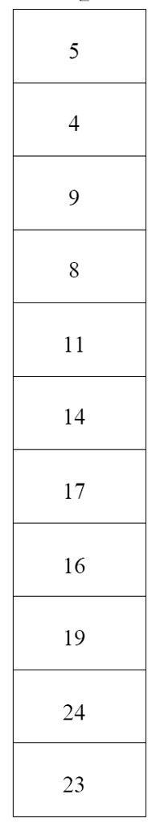
DFS and variants
Depth first search
Do DFS on the search graph. Backtrack from infeasible terminal nodes.
Visit node at top of stack. Add new unvisited nodes to top of stack.
Depth first branch and bound
Search in DFS order, but cut off branches using BB.
Iterative deepening A*
DFS can search very deep in part of the tree, whereas a better solution exists higher up.
Instead, do multiple rounds of DFS, each round searching deeper.
For each search, set an upper bound B for cost. If current node n has f(n) > B, then backtrack.
On the next round, increase B to smallest non-explored f(n) value from last round.
For first round, set B = f(root).
Other more advanced algorithms used in practice include cutting plane methods and branch and cut.
top of stack

Slide 10
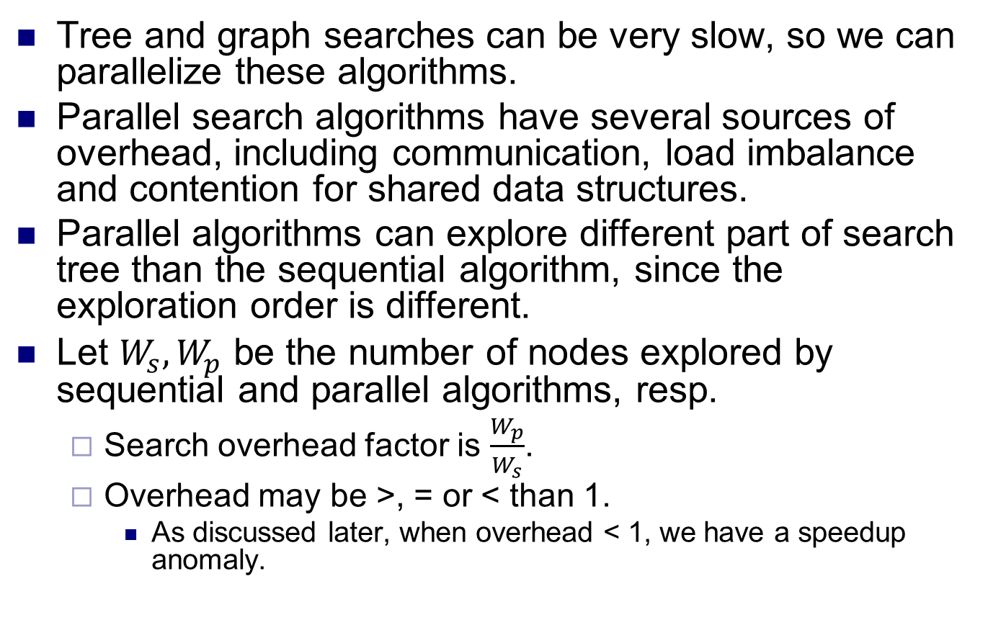
Parallel search
Tree and graph searches can be very slow, so we can parallelize these algorithms.
Parallel search algorithms have several sources of overhead, including communication, load imbalance and contention for shared data structures.
Parallel algorithms can explore different part of search tree than the sequential algorithm, since the exploration order is different.
Let $W_{s}, W_{p}$ be the number of nodes explored by sequential and parallel algorithms, resp.
Search overhead factor is $\frac{W_{p}}{W_{s}}$.
Overhead may be >, = or < than 1.
As discussed later, when overhead < 1, we have a speedup anomaly.

Slide 11
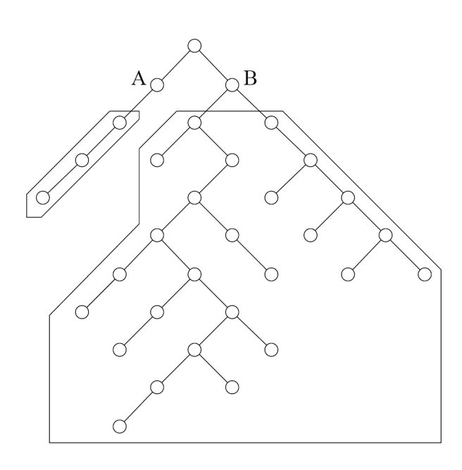
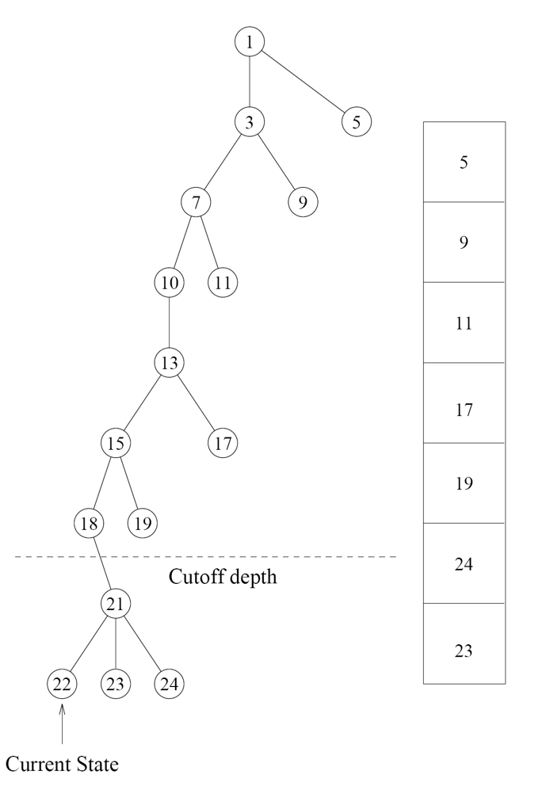
Parallel DFS
To parallelize DFS, can assign different processors parts of the DFS stack to explore.
Static assignments cause poor load balancing, since different brances have different sizes.
Hard to estimate the sizes of branches. So instead, do dynamic load balancing.
Can use e.g. the work-stealing algorithm from previous lecture.
Control how much to steal.
Stealing too little causes overhead from many steals.
Stealing too much can cause poor load balancing.
Also choose who to steal from.
In asynchronous round robin, processors choose victims independently, and round robin through them.
In global round robin, processors maintain victim in a global variable, and round robin through them.
In randomized work stealing, nodes pick victim randomly.
To avoid sending very small amounts of work, set a cutoff depth and don’t send work past cutoff.

Slide 12
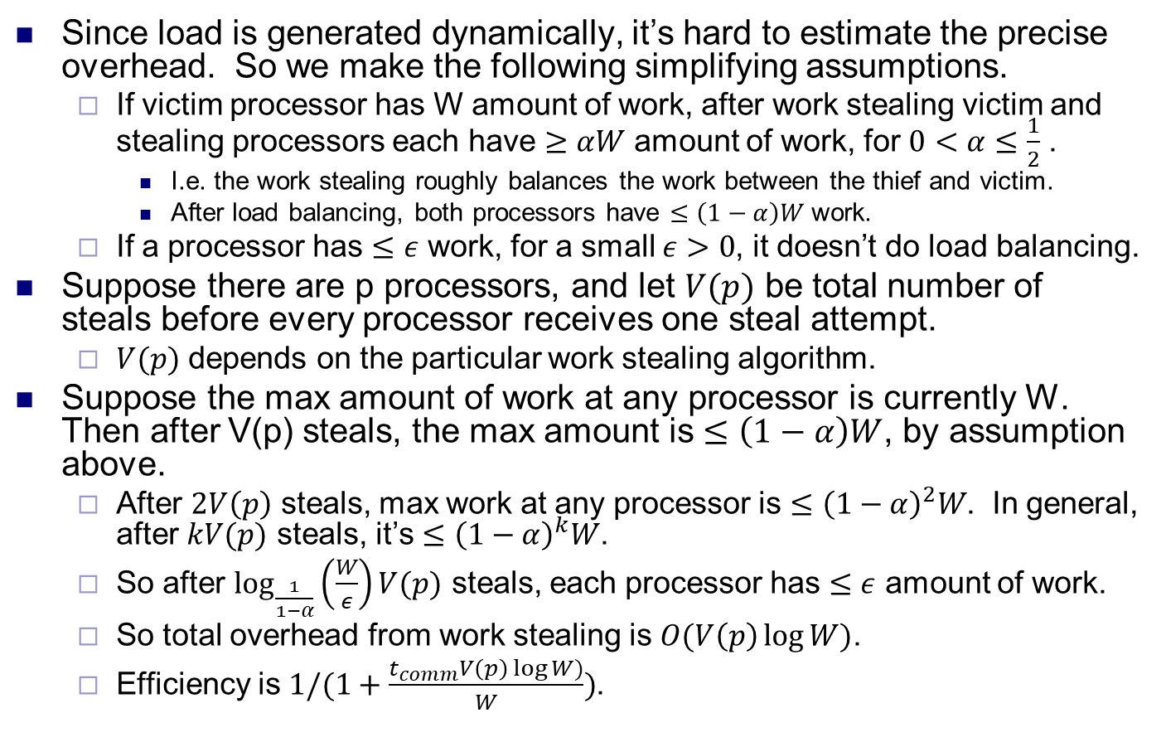
Load balancing overhead
Since load is generated dynamically, it’s hard to estimate the precise overhead. So we make the following simplifying assumptions.
If victim processor has W amount of work, after work stealing victim and stealing processors each have $≥αW$ amount of work, for $0<α≤\frac{1}{2}$ .
I.e. the work stealing roughly balances the work between the thief and victim.
After load balancing, both processors have $≤\left(1−α\right)W$ work.
If a processor has $≤ε$ work, for a small $ε>0$, it doesn’t do load balancing.
Suppose there are p processors, and let $V(p)$ be total number of steals before every processor receives one steal attempt.
$V(p)$ depends on the particular work stealing algorithm.
Suppose the max amount of work at any processor is currently W. Then after V(p) steals, the max amount is $≤\left(1−α\right)W$, by assumption above.
After $2V\left(p\right)$ steals, max work at any processor is $≤{\left(1−α\right)}^{2}W$. In general, after $kV(p)$ steals, it’s $≤{\left(1−α\right)}^{k}W$.
So after $\log_{\frac{1}{1−α}}\left(\frac{W}{ε}\right)V(p)$ steals, each processor has $≤ε$ amount of work.
So total overhead from work stealing is $O(V\left(p\right)\log{W)}$.
Efficiency is $1/(1+\frac{t_{comm}V\left(p\right)\log{W)}}{W})$.

Slide 13
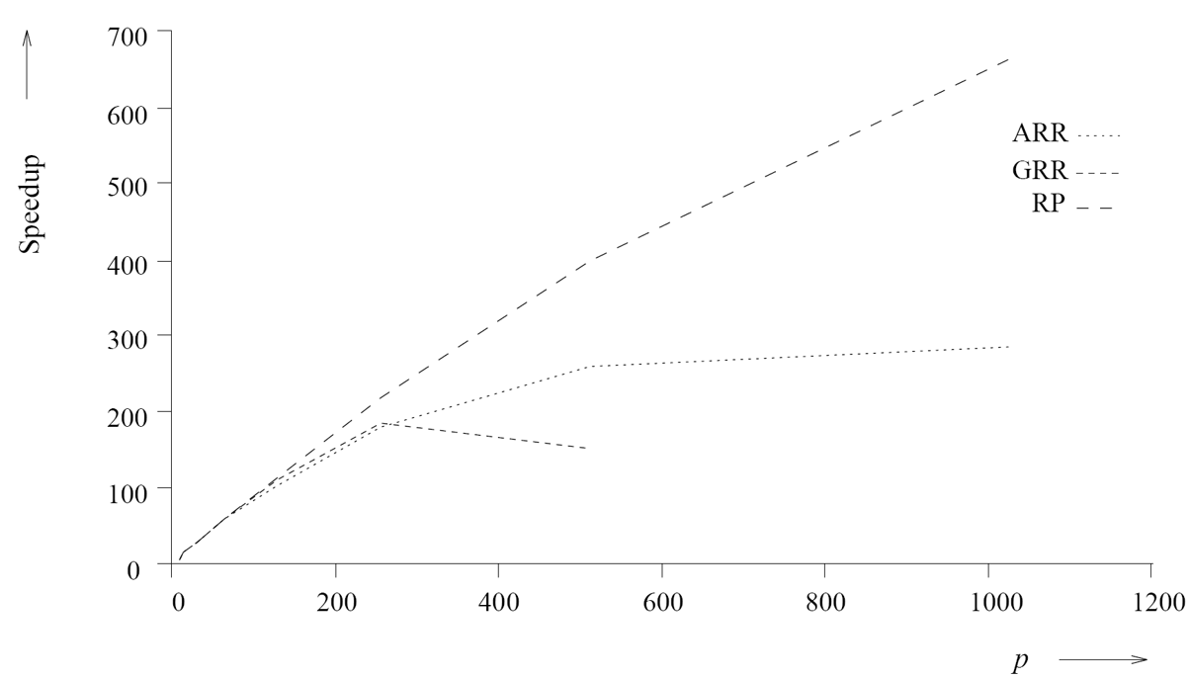
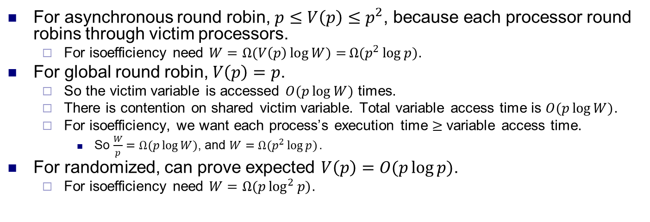
Load balancing overhead
For asynchronous round robin, $p≤V\left(p\right)≤p^{2}$, because each processor round robins through victim processors.
For isoefficiency need $W=Ω(V\left(p\right)\log{W)=}Ω(p^{2}\log{p)}$.
For global round robin, $V\left(p\right)=p$.
So the victim variable is accessed $O(p\log{W)}$ times.
There is contention on shared victim variable. Total variable access time is $O(p\log{W)}$.
For isoefficiency, we want each process’s execution time $≥$ variable access time.
So $\frac{W}{p}=Ω(p\log{W)}$, and $W=Ω(p^{2}\log{p)}.$
For randomized, can prove expected $V\left(p\right)=O(p\log{p)}$.
For isoefficiency need $W=Ω(p\log^{2}{p)}$.

Slide 14
Parallel DFBB and IDA*
To parallelize depth first branch and bound, processors store the globally best solution.
If a processor finds a better solution, it broadcasts it.
Since the best solution changes infrequently, there’s not much overhead.
For parallel IDA*, broadcast the bound for each round of DFS, then parallelize the DFS.

Slide 15
Parallel A*
In A*, the cost of nodes are stored in a priority queue.
Parallelizing A* requires accessing the queue in parallel.
With p processors, expand smallest p nodes in queue.
This expands some nodes that aren’t expanded in the sequential algorithm, leading to redundant work.
Another problem is contention when accessing the queue.
To decrease contention, can give each processor its own copy of the queue.
If a processor finds a good node (with small f(n)), it should update other nodes so they don’t expand non-minimal nodes.
More updates reduces redundancy but increases communication, so need to find a tradeoff.
If the search graph is not a tree, then can visit the same node multiple times, so need duplicate detection.
Can store visited nodes in a hash table and distribute hash table among processors.
Causes communication for each node visited.
Can be amortized if amount of computation per node is large.

Slide 16
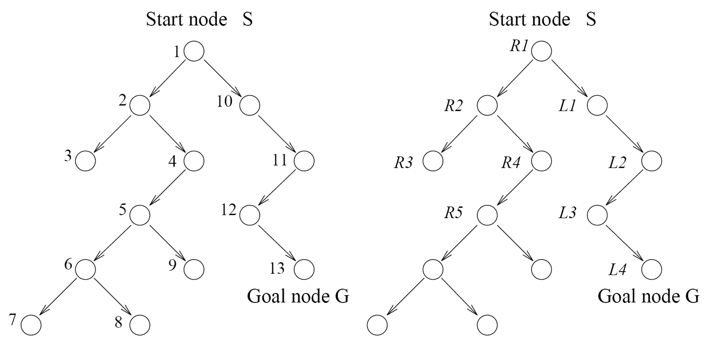
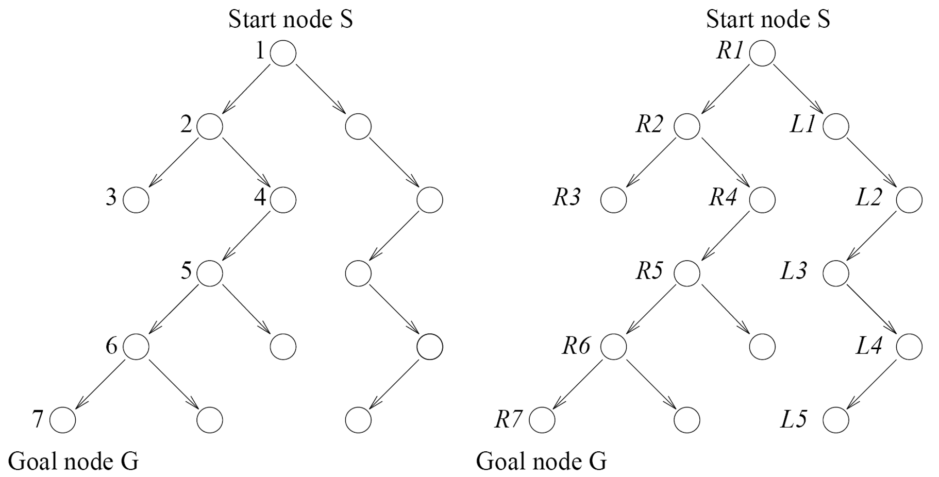
Speedup anomalies
Since parallel search explores nodes in a different order than sequential search, it can explore fewer or more nodes.
Ex In the upper figures, the sequential search on the left explores 13 nodes before finding the goal. On the right, parallel search using two processors R and L explores 9 nodes.
There is a superlinear speedup of 13/5 > 2.
This is called an acceleration anomaly.
Ex In the lower figures, the left sequential search explores 7 nodes, but the right parallel search explores 12 nodes.
This is called a deceleration anomaly.

Slide 17
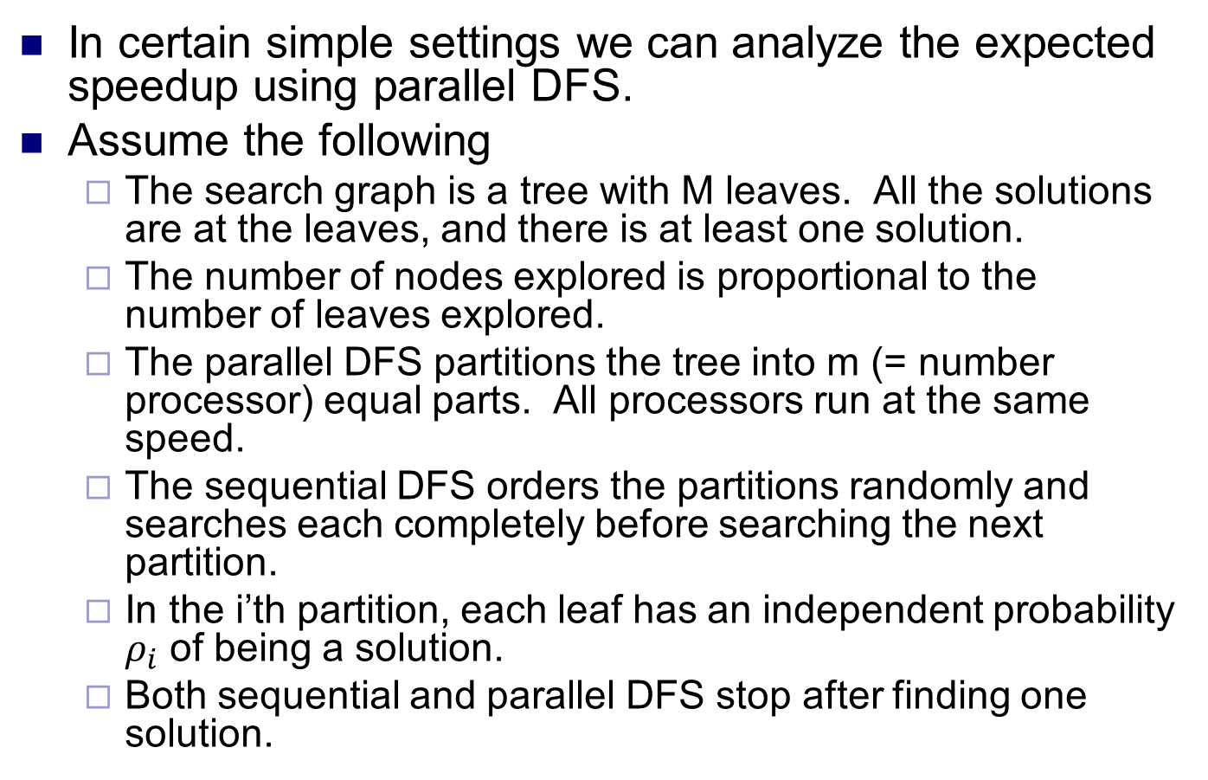
Average speedup in DFS
In certain simple settings we can analyze the expected speedup using parallel DFS.
Assume the following
The search graph is a tree with M leaves. All the solutions are at the leaves, and there is at least one solution.
The number of nodes explored is proportional to the number of leaves explored.
The parallel DFS partitions the tree into m (= number processor) equal parts. All processors run at the same speed.
The sequential DFS orders the partitions randomly and searches each completely before searching the next partition.
In the i’th partition, each leaf has an independent probability $ρ_{i}$ of being a solution.
Both sequential and parallel DFS stop after finding one solution.

Slide 18
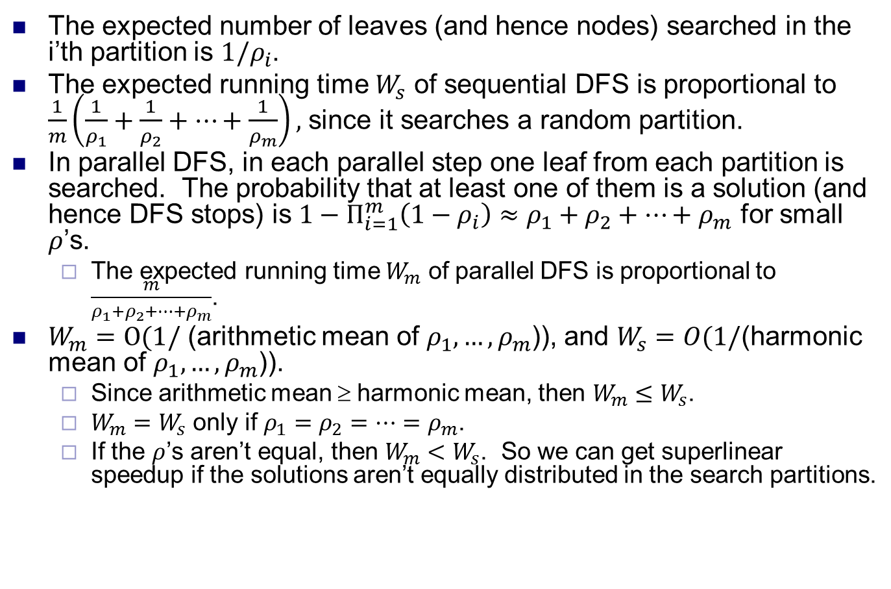
Average speedup in DFS
The expected number of leaves (and hence nodes) searched in the i’th partition is $1/ρ_{i}$.
The expected running time $W_{s}$ of sequential DFS is proportional to $\frac{1}{m}\left(\frac{1}{ρ_{1}}+\frac{1}{ρ_{2}}+…+\frac{1}{ρ_{m}}\right),$ since it searches a random partition.
In parallel DFS, in each parallel step one leaf from each partition is searched. The probability that at least one of them is a solution (and hence DFS stops) is $1−Π_{i=1}^{m}\left(1−ρ_{i}\right)≈ρ_{1}+ρ_{2}+…+ρ_{m}$ for small $ρ$’s.
The expected running time $W_{m}$ of parallel DFS is proportional to $\frac{m}{ρ_{1}+ρ_{2}+…+ρ_{m}}$.
$W_{m}=O(1/$ (arithmetic mean of $ρ_{1},…,ρ_{m}$)), and $W_{s}=O(1/$(harmonic mean of $ρ_{1},…,ρ_{m}$)).
Since arithmetic mean ≥ harmonic mean, then $W_{m}≤W_{s}$.
$W_{m}=W_{s}$ only if $ρ_{1}=ρ_{2}=…=ρ_{m}$.
If the $ρ$’s aren’t equal, then $W_{m}<W_{s}$. So we can get superlinear speedup if the solutions aren’t equally distributed in the search partitions.

